Slide 1
Volunteer Opportunities for Employees

Slide 2
What Is Operation Give Back?
Employee volunteer program
Coordinated by Brian Sarkar, Practice Manager
Opportunities to volunteer with fellow employees
Do good
Feel good!
Three days scheduled each year

Slide 3
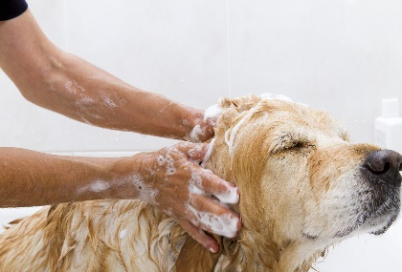
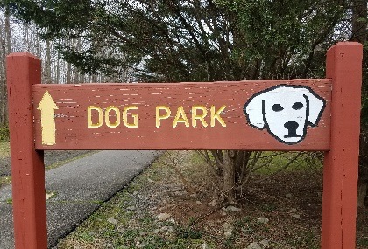
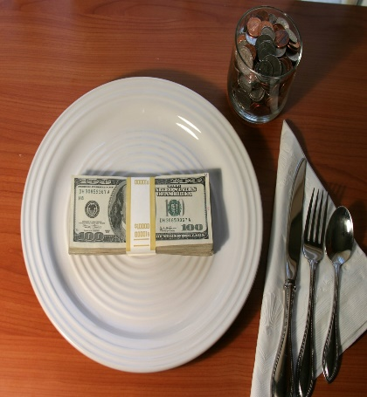
2021 Give Back Days
Except the first cell | Description | Date
 | Groom animals at city animal | Saturday, April 24
 | Clean up city dog parks | Saturday, June 19
 | Annual fundraiser dinner for city animal shelter | Sunday, September 12

Slide 4
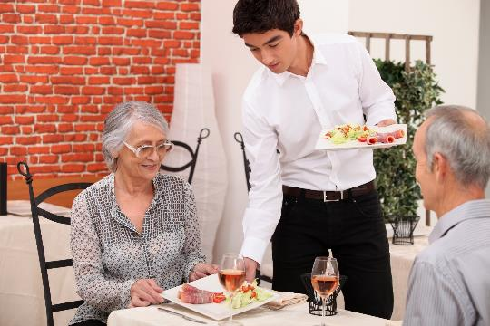
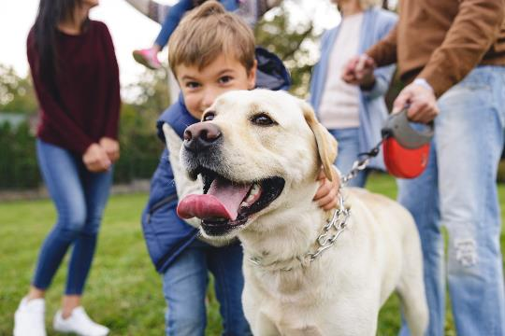
Scenes from Last Year

Slide 5

Ben Kim, veterinary technician, waiting tables at Last year’s fundraiser

Slide 6


Randy, son of Kathy Turner, HR Director, enjoying the dog park after the clean-up last year

Slide 7



Join the Gang!

Slide 8


Slide 9
Sign Up Today!
Brian Sarkar b.sarkar@wvh.example.com
or
Tereza Gon\;alves t.goncalves@wvh.example.com
This way to feel great and help others!

